Slide 1
Static and Subforms

Slide 2
What if you only ever need one?
Some times we need only one of something.
One company has all of the warehouses.
One University provides all of the courses for students
One environment provides all of the weather.

Slide 3

Not only one thing but one tool
We can also create tool libraries that we can use over and over again.

Slide 4
When to use statics
Data rarely changes
If changes, affects every instance of that class everywhere.
Save state or share state between different parts of the code.
Collections of actions that do not need data attached to them.
Forces all objects to use a common set of data.

Slide 5
We can make static classes
This is the magic “static” keyword you saw in Java.
Static classes exist once and only once.
Never instantiated
Because there can be only one.

Slide 6
Example
Static Keyword
static class CommonTools {
public static int addTwoNumbers(int x, int y) {
return x + y;
}
public static string addTwoStrings(String t, String t2) {
return t + t2;
}
}
Methods must be static too

Slide 7
Calling static class methods
int sum = CommonTools.addTwoNumbers(2, 3);
string s = CommonTools.addTwoStrings("a", "b");
Do not need to instantiate object to use methods
Same object is used everywhere.

Slide 8
Example
Can contain static fields
static class CommonTools {
public static int numberOfStaticness;
public static int addTwoNumbers(int x, int y) {
return x + y;
}
public static string addTwoStrings(String t, String t2) {
return t + t2;
}
}

Slide 9
Variable shared across all forms
public Form1() {
InitializeComponent();
CommonTools.numberOfStaticness = 3;
}
public Form2() {
InitializeComponent();
CommonTools.numberOfStaticness = 5;
}
Will change it across everywhere this is used.
public Form3() {
InitializeComponent();
CommonTools.numberOfStaticness = 7;
}

Slide 10
Cannot instantiate static classes
CommonTools cmt = new CommonTools();
Will throw error
Remember there can only be one of these, period.

Slide 11
Multiple forms

Slide 12
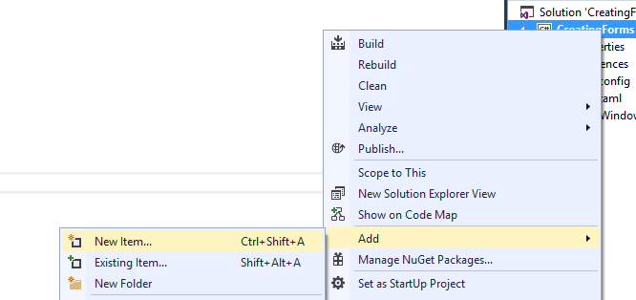
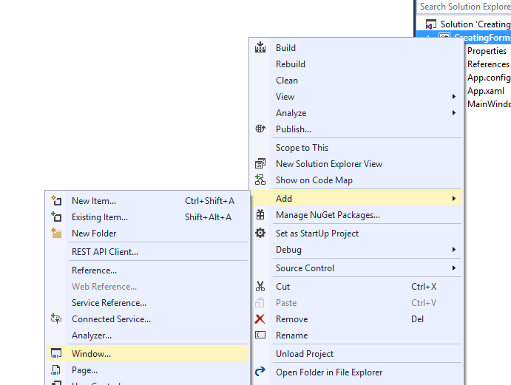
Right-click on Project
Approach 1
or
Approach 2

Slide 13
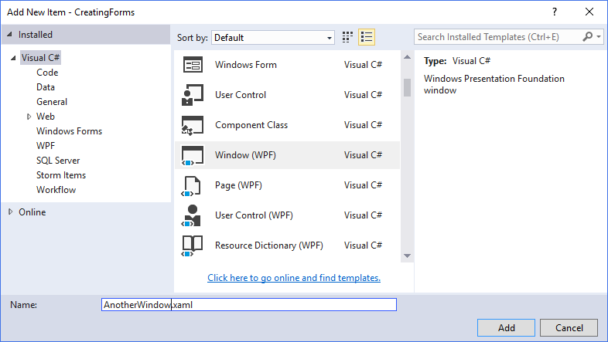
Pick and Name
Pick
Name

Slide 14
Creating new forms
Forms are just UI objects created from classes.
public partial class MainWindow : Window {
public MainWindow() {
InitializeComponent();
}
}
public partial class AnotherWindow : Window {
public AnotherWindow() {
InitializeComponent();
}
}

Slide 15
Show a window from a button click
private void btnCreateNewForm_Click(object sender, RoutedEventArgs e) {
// create a window obect
AnotherWindow aw = new AnotherWindow();
// tell the window to show
aw.Show();
}
Can work in either window

Slide 16
Show as modal window
private void btnCreateNewForm_Click(object sender, RoutedEventArgs e) {
// create a window obect
AnotherWindow aw = new AnotherWindow();
// tell the window to show
aw.ShowDialog();
}
Until the shown windows is closed no other windows can be used (we call this a modal)
Sometimes called a subform or child form.

Slide 17
Closing a open window programmatically
private void btnCloseMe_Click(object sender, RoutedEventArgs e) {
// tell the window to go away
this.Close();
}
Closes the current window
Use this (it is an object remember)
Focus returns to the last active window

Slide 18
Closing a open window programmatically
private void btnCloseMe_Click(object sender, RoutedEventArgs e) {
// tell the window to go away
this.Close();
}
Closes the current window
Use this (it is an object remember)
Focus returns to the last active window

Slide 19
Close an application
private void btnCloseApp_Click(object sender, RoutedEventArgs e) {
// tell your application to quit
Application.Current.Shutdown();
}
Shuts down (closes) your whole application

